Slide 1
Decorator Pattern
Navn | Au-id | Studienummer:
Erda Naz Cecillia Kocaman Bal | Au549640 | 201900001
Murat Eroglu | Au638962 | 201906338
Oleksandr Zubrytskyy | Au635799 | 201908679
Simon Shahrour | Au624634 | 201810704

Slide 2
Decorator Pattern
Formål
Decorator som en løsning
Strukture

Slide 3
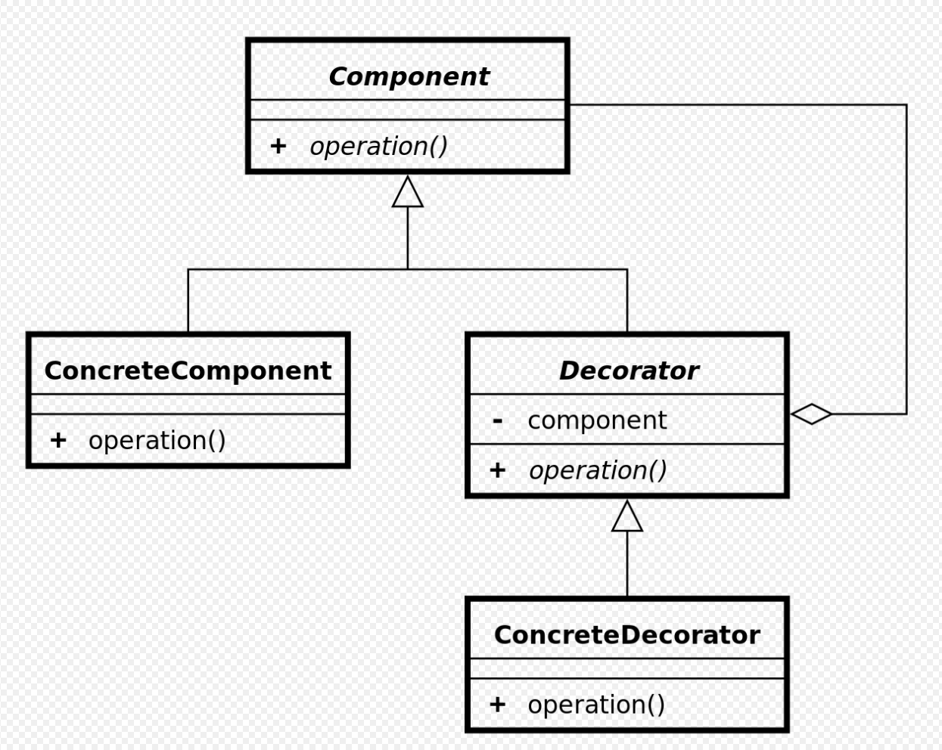
Strukture

Slide 4
Problematikken

Slide 5
Løsning

Slide 6
Perspektivering
Adapter
Strategy

Slide 7
Reference
Decorator pa ttern – Wikipedia
Adapter vs Decorator vs Facade vs Proxy Design Pattern in Java (javarevisited.blogspot.com)
PowerPoint Presentation (au.dk)

